Slide 1
Beyond Basic AngularJS
Demo Project: https://github.com/webedge/BeyondBasicAngularJS
@jonharding

Slide 2





































TITANIUM SPONSORS
Platinum Sponsors
Gold Sponsors

Slide 3


Slide 4
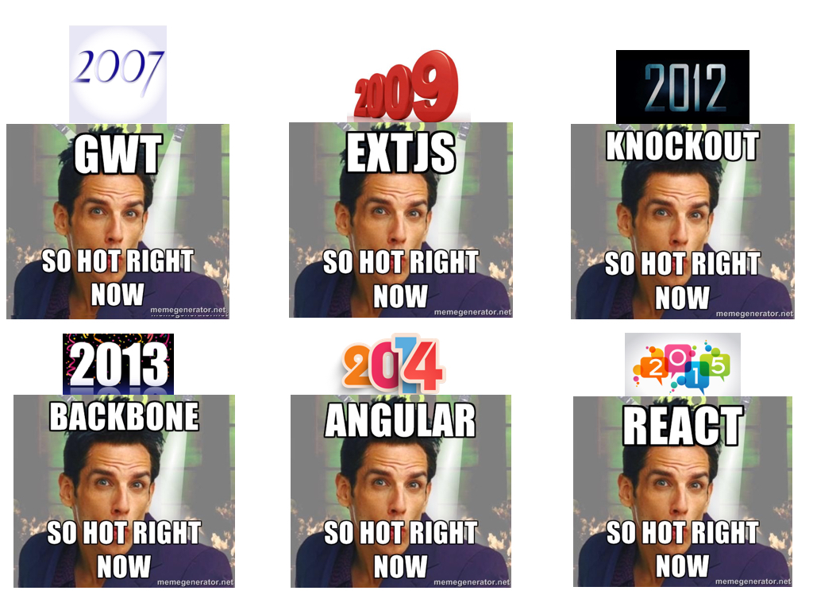
http://blog.bitovi.com/longevity-or-lack-thereof-in-javascript-frameworks/

Slide 5
What this is not
Hello World
How to create your own custom filter
Difference services and factories

Slide 6
What this is
Examples of what’s worked for us
John Papa’s Style Guide
Module Separation
Routing
Controller as Syntax
Scope concerning controller / directive
Build Techniques

Slide 7
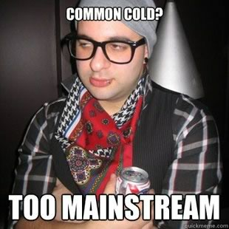
I promise this isn’t hip

Slide 8
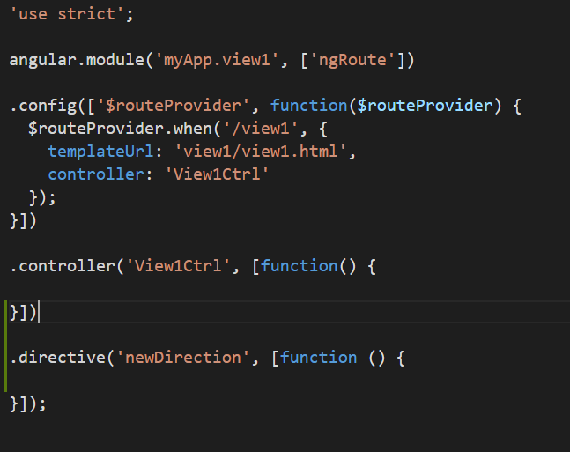
The Problem : Separation of Concerns
View Config
Controller
Directive

Slide 9
The Problem : Organization
controllers
directives
views
app.css

Slide 10

BB CarLot

Slide 11
IIFE
IIFE
An immediately-invoked function expression (or IIFE, pronounced "iffy") is a JavaScript design pattern which produces a lexical scope using JavaScript's function scoping.
(lexical scope - referenced from within the block)

Slide 12
IIFE
IIFE
Notes:
Douglas Crockford doesn’t like this syntax

Slide 13

IIFE
IIFE
https://youtu.be/taaEzHI9xyY?t=2018

Slide 14


Slide 15
Organization
Notes:
Not 100% feature driven. data, & layout should maybe go in the shared folder. But this pattern works for us.

Slide 16
Organization
Notes:
Angular2 will get rid of this favoring the EMCA 6 javascript modules
You’ll see comments that actually help with the build process

Slide 17
Separation of Concerns
Factories - Used to retrieve API calls
Services – Used to common functions
Controllers - Business Logic
Directives - DOM Manipulation

Slide 18
Module Separation
DO
DON’T
Avoid var app = angular.module(‘beyond-basic’, [])
vs

Slide 19
IIFE
Module Separation
Unique names help avoid module name collisions.

Slide 20
Module Separation
Think of modules as reusable blocks

Slide 21
Module Separation
Think of modules as reusable blocks

Slide 22

beyond-basic (ng-app)
beyond-basic-data
beyond-basic-dashboard
beyond-basic-inventory

Slide 23
Routing
Angular 1 - Use UI Router
Resolves are your friend (but don’t abuse them)
Make use of $stateChangeSuccess, $stateChangeError

Slide 24
beyond-basic (ng-app)
beyond-basic-data
UI-Router
beyond-basic-dashboard
beyond-basic-inventory
Dashboard
Inventory

Slide 25
Controllers as vm
Use the controllerAs syntax over using $scope
It allows the binding to be “dotted” vm.name
Assign controllers in routes
Can be very helpful in nested situations
parent.name
child.name

Slide 26
Controllers - Bindable Members Up Top
We spend more time reading our code than we do writing it.

Slide 27
Directives
Before writing the directives take time to think about how they will interact with each other.
Make a decision how to handle shared / isolated scope If you have the need for $parent it’s possible you didn’t need isolated scope
ControllerAs syntax on Directives

Slide 28
beyond-basic
beyond-basic-data
beyond-basic-dashboard
UI-Router
beyond-basic-inventory
Factories
Factories
Dashboard
Inventory
Inventory
Filter
Customers
Inventory-list
Prospects

Slide 29
One Liners (Or close to it)

Slide 30
$http calls to one shared $digest
app.controller('Ctrl', function ($http) {
// Make XHR and update model accordingly
$http.get('fetch/some/json/').then(function (response) { this.myModel = response.data; }.bind(this));
});
app.config(function ($httpProvider) { $httpProvider.useApplyAsync(true); });
Notes:
$digest – User interacts with events, HttpRequests, Timeouts
$scope.apply() triggers $digest internally

Slide 31
ng-repeat track by X
ng-repeat="cars in vm.inventoryTypes track by $index”
Notes:
$digest – User interacts with events, HttpRequets, Timeouts
$scope.apply() triggers $digest internally

Slide 32
One Liner
Strong people don't put others down.
They lift them up and slam them on the ground for maximum damage.

Slide 33
Disabling debug info
app.controller('Ctrl', [‘$scope’, function ($scope) {
$scope.name = ‘Harding’;
});
<p>Hello {{name}}!</p>
<p class=“ng-binding”>Hello Harding!</p>

Slide 34
Disabling debug info
app.config([‘$compileProvider’, function ($compileProvider) {
$compileProvider.debugInfoEnabled(false);
});

Slide 35
One Liner
I want to die peacefully like my grandpa.
Not like the passengers who went kicking and screaming.

Slide 36
Disabling Logging
USE IT
LIBERALLY

Slide 37


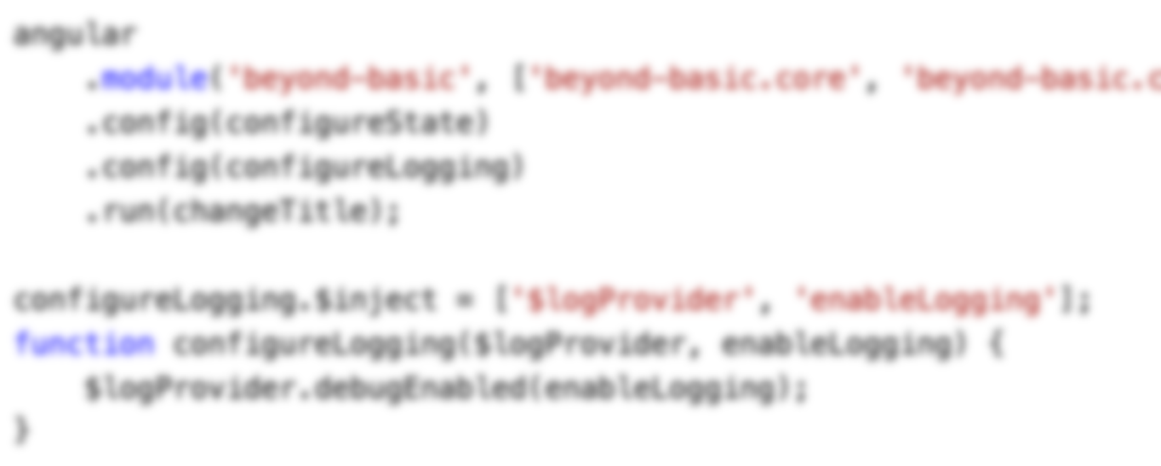
Disabling Logging
USE IT
LIBERALLY
OR GET
BURNT

Slide 38
One Liner
Strong people don't put others down.
They lift them up and slam them on the ground for maximum damage.

Slide 39
Cool Stuff

Slide 40
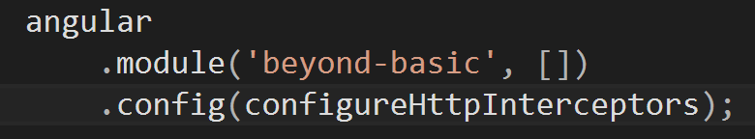
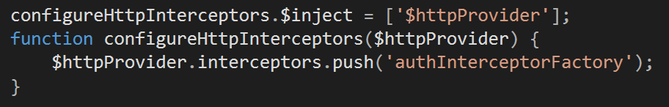
Interceptors

Slide 41
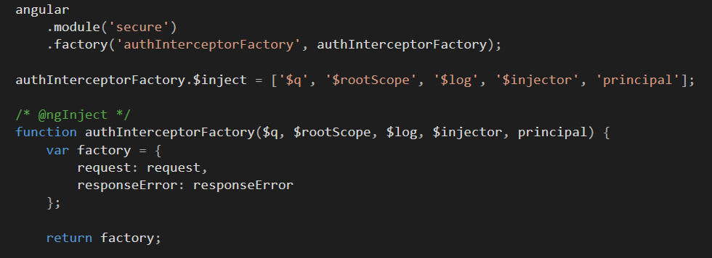
Interceptors

Slide 42
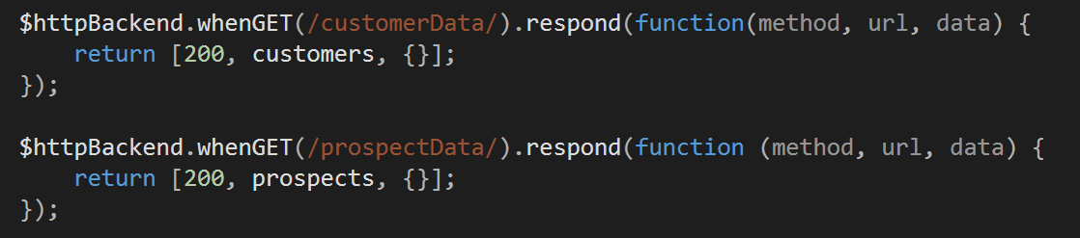
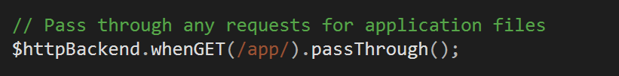
Angular-Mock
Add $httpBackend pattern to API calls you want to intercept:
Allow HTML Files etc to not be mocked:
Notes:
I have added some script that will help simulate network delay.

Slide 43


Build Process
VS

Slide 45
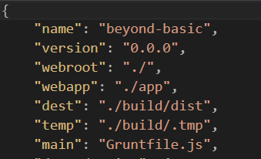
Build Process
package.json

Slide 46
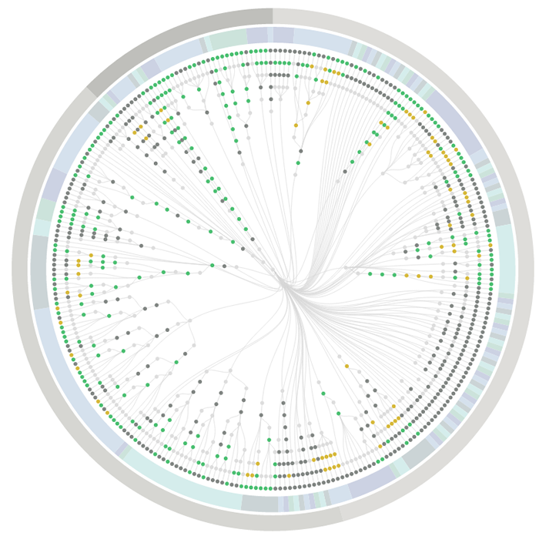
Testing - PhantomFlow
UI testing with decision trees. An experimental approach to UI testing, based on Decision Trees.
NodeJS wrapper forPhantomJS, CasperJS and PhantomCSS, PhantomFlow enables a fluent way of describing user flows in code whilst generating structured tree data for visualisation.

Slide 47
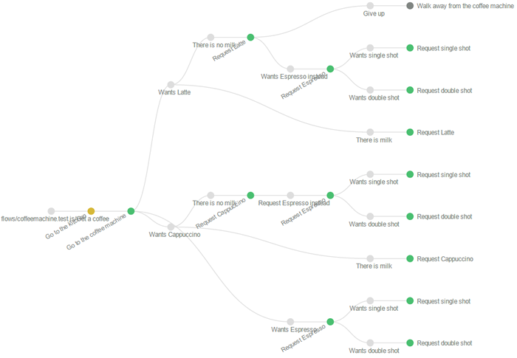
Testing - PhantomFlow
UI testing with decision trees. An experimental approach to UI testing, based on Decision Trees.
NodeJS wrapper forPhantomJS, CasperJS and PhantomCSS, PhantomFlow enables a fluent way of describing user flows in code whilst generating structured tree data for visualisation.

Slide 48
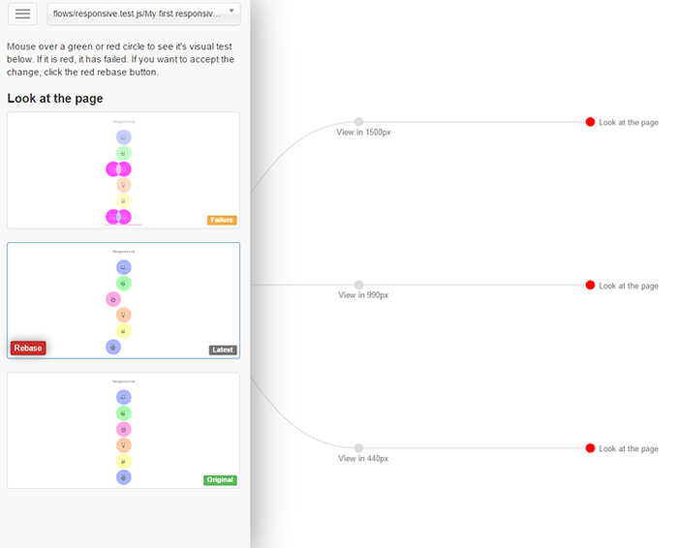
Testing - PhantomFlow
UI testing with decision trees. An experimental approach to UI testing, based on Decision Trees.
NodeJS wrapper forPhantomJS, CasperJS and PhantomCSS, PhantomFlow enables a fluent way of describing user flows in code whilst generating structured tree data for visualisation.

Slide 49
Beyond Basic AngularJS
Demo Project: https://github.com/webedge/BeyondBasicAngularJS
@jonharding

